Slide 1
Medical Diagnosis Expert System: Sleep Disorder Prediction
Group 5

Slide 2
Group Members
01
02
03
Md. Harun or rashid
ID- 2021254642
Nasid Ahmed Chowdhury
ID- 2012816642
Masum Musfiq
ID- 2013334042

Slide 3
What is Sleep Disorder ?
Sleep is important for keeping our body and mind healthy. Experts can study sleep patterns to understand how well a person is resting. However, sleep disorders like insomnia, sleep apnea, and restless leg syndrome can disturb sleep, leading to tiredness, mood swings, and trouble thinking clearly.

Slide 4
Why Sleep Disorder Prediction?
Sleep disorders affect millions of people worldwide, leading to serious health issues such as fatigue, poor concentration, and increased risk of chronic diseases. Early detection and management of these disorders can significantly improve a person’s quality of life. However, diagnosing sleep disorders often requires expensive and time-consuming procedures, like sleep studies in labs.
This motivated us to develop a system that uses machine learning to predict sleep disorders efficiently and accurately. By leveraging various ML models, the goal is to create a cost-effective and accessible solution that can assist healthcare professionals and individuals in identifying potential sleep disorders early, ultimately contributing to better health outcomes.

Slide 5
The Dataset
Dataset:
https://www.kaggle.com/datasets/uom190346a/sleep-health-and-lifestyle-dataset
FEATURES 12 & 375 samples
Person Id | Gender | Age | Occupation
Sleep Duration | Quality of Sleep | Physical Activity Level | Stress Level
BMI Category | Blood Pressure | Heart Rate | Daily Steps

Slide 6
The Machine Learning Models
We have used six machine learning models.
Models | Default | Tuned Hyperparameter
Decision Tree | 90.6% | 90.6%
Random Forest | 88% | 88%
KNN | 86.6% | 88%
SVM | 64% | 88%
Bagging | 88% | 88%
Logistic Regression | 84% | 88%

Slide 7
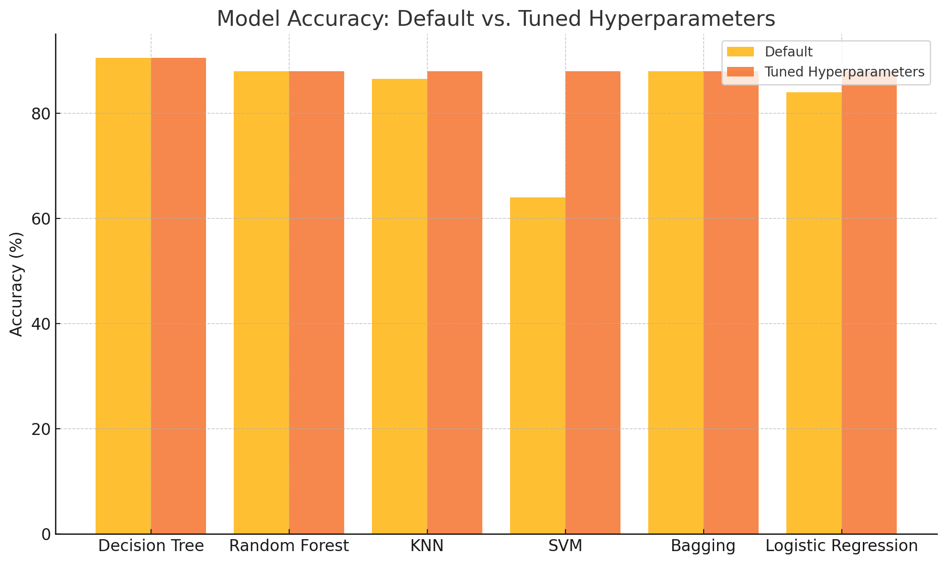
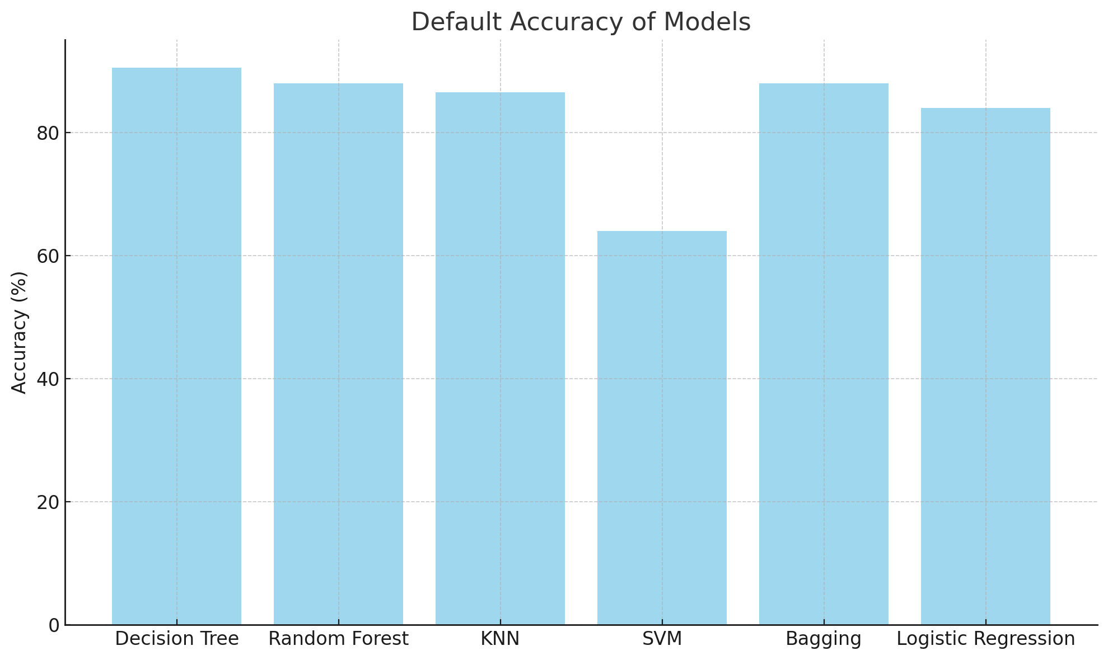
Results
The Decision Tree model achieved the highest accuracy of 90.67%, outperforming all other models in this comparison.

Slide 8
Conclusion
The Decision Tree model achieved the highest accuracy of 90.6%, proving its effectiveness in sleep disorder prediction. Hyperparameter tuning improved models like SVM, emphasizing the value of optimization. This project highlights the potential of machine learning in early diagnosis, paving the way for more robust and scalable solutions in the future.

Slide 9
Thank You

